Slide 1
SF Crime Data Project
Group 6: Leeza Sergeeva, Ezana Kemmer, Luis Rodriguez, Fernanda Nunes

Slide 2
Introduction to Data
Our data was collected from 2003-2018 and released by the SF police department as a part of it’s open data initiative for greater transparency.
However, we decided to cut off the data at 2018 as it was only recorded up until May of that year making the data set unbalanced.
It consists of unique incident numbers, types of crimes, description of crimes, police districts, streets where crimes occur, time of crime, date of crime, resolution of crime, address, and location(in coordinates).

Slide 3
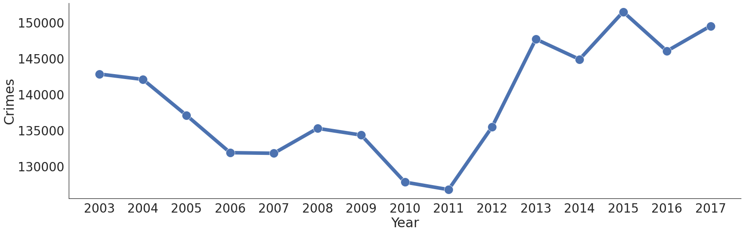
Crime Trend
Luis

Slide 4
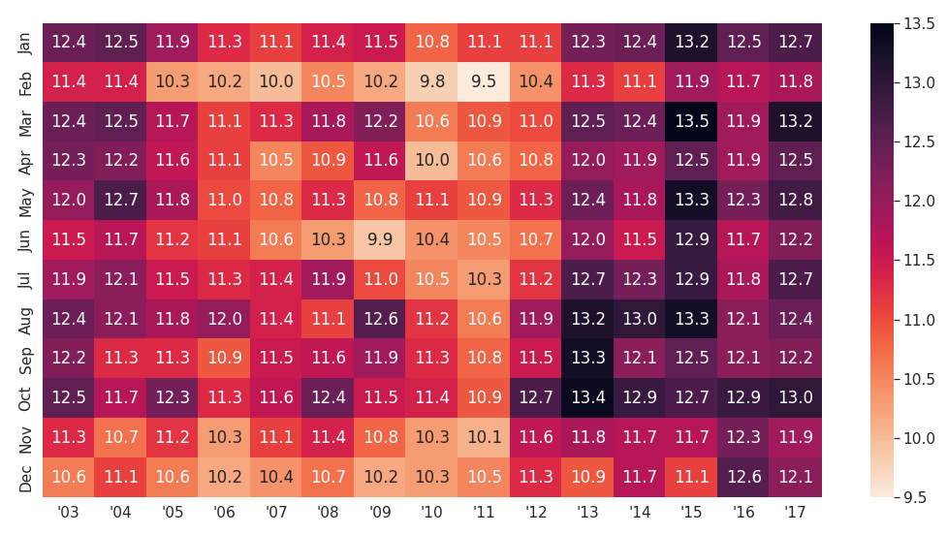
Crime from 2003-2017 by Month
We can see a seasonality of crime here with winter months having less crime(with the exception of January)than other months.
Also note how dark the column is for 2015. Looks like it was an active year.
Ezana Kemmer

Slide 5
Reported Crimes
Least Reported Years
Most Reported Years
 | Year | Crimes | Crimes Per Day
 | 2011 | 126713 | 347.158904
 | 2010 | 127758 | 350.021918
 | 2007 | 131771 | 361.016438
 | 2006 | 131856 | 361.249315
 | 2009 | 134309 | 367.969863
 | Year | Crimes | Crimes Per Day
 | 2015 | 151459 | 414.956164
 | 2017 | 149487 | 409.553425
 | 2013 | 147664 | 404.558904
 | 2016 | 145994 | 399.983562
 | 2014 | 144844 | 396.832877
Luis

Slide 6
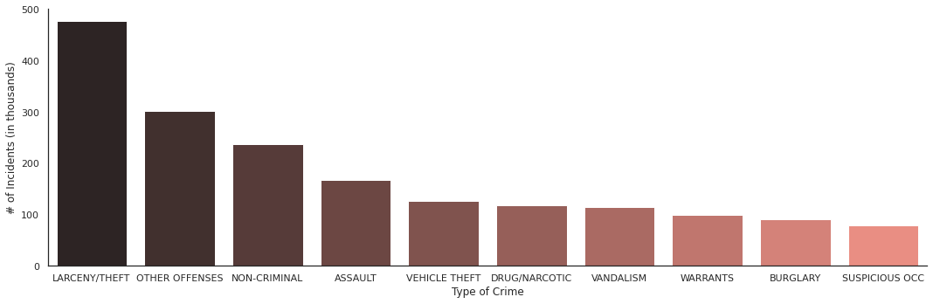
Most common types of crimes in SF from 2003-2017
Larceny/Theft is the category crime with the most incidents in San Francisco
478
302
237
167
126
118
115
100
91
79
Fernanda Nunes

Slide 7
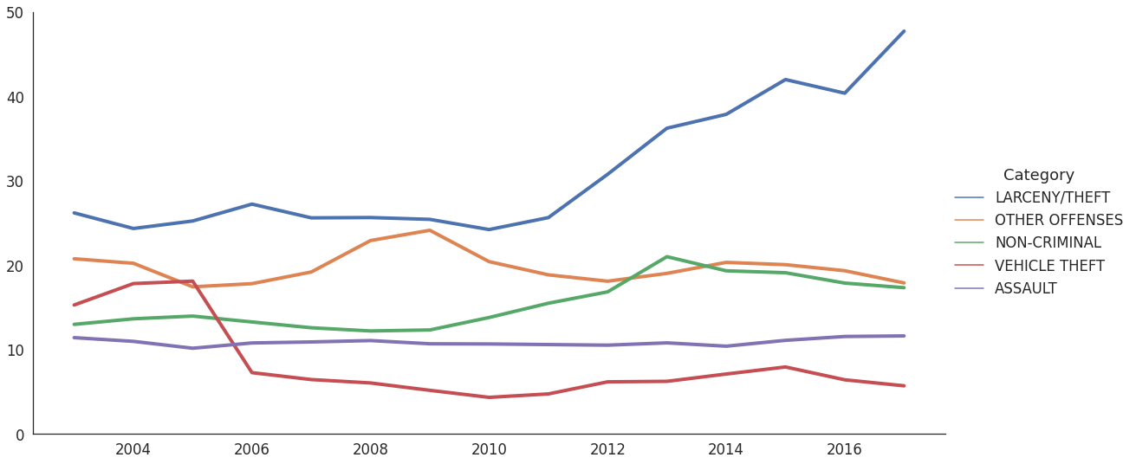
Top 5 Crimes in SF
Prop 47 is passed in 2014
Mayoral Change from Newsome to Lee in 2011
Number of Crimes(In Thousands)
Ezana Kemmer

Slide 8
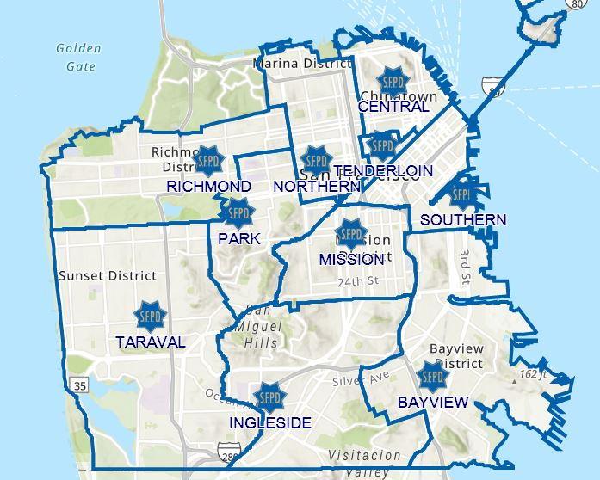
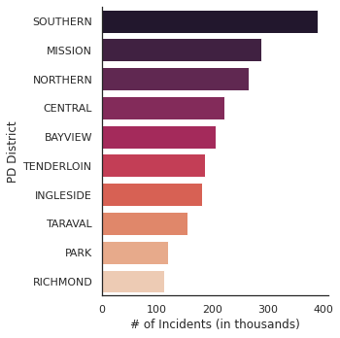
# of Incidents by PD Districts
Top 10 Districts with the most incidents
Fernanda Nunes
Source: https://twitter.com/sfsafe/status/1296145166588420097

Slide 9
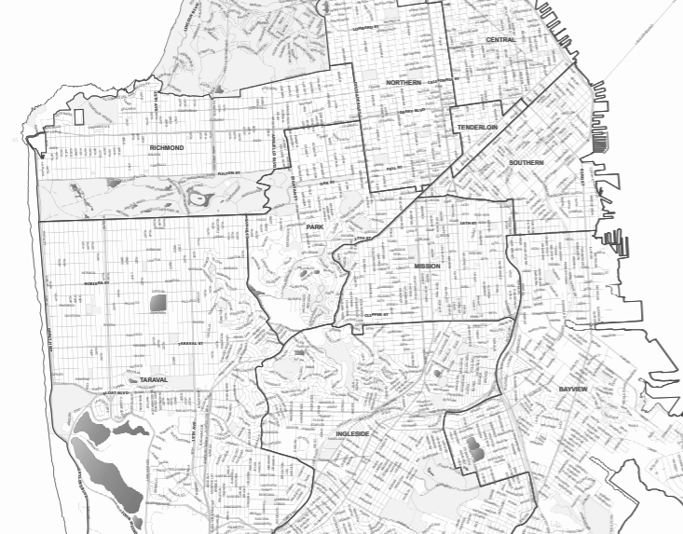
# of Incidents by PD Districts
Top 10 Districts with the most incidents
CENTRAL
NORTHERN
TENDERLOIN
RICHMOND
SOUTHERN
PARK
MISSION
TARAVAL
BAYVIEW
INGLESIDE
Source: sfgov.org
Fernanda Nunes

Slide 10
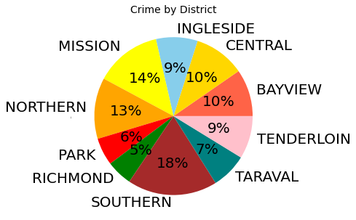
Breakdown by the District
Luis

Slide 11
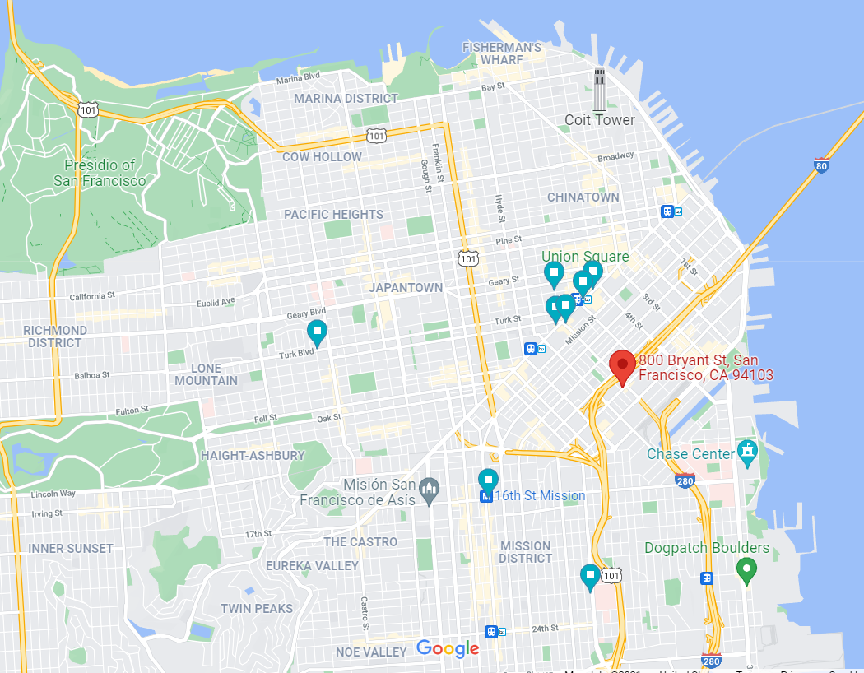
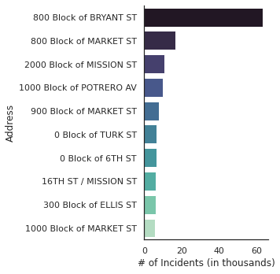
# of Incidents by Addresses
Top 10 Addresses with the most incidents
Fernanda Nunes
Source: https://www.google.com/maps/@37.7773264,-122.416137,13.06z

Slide 12
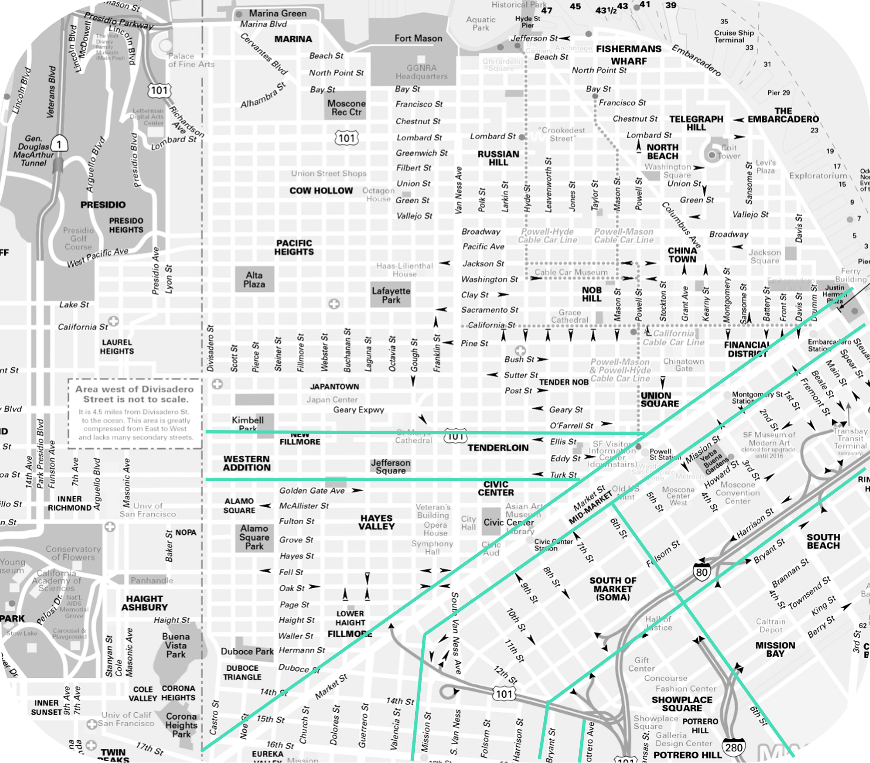
# of Incidents by Addresses
Top 10 Addresses with the most incidents
Source: mapaplan.com
Fernanda Nunes

Slide 13
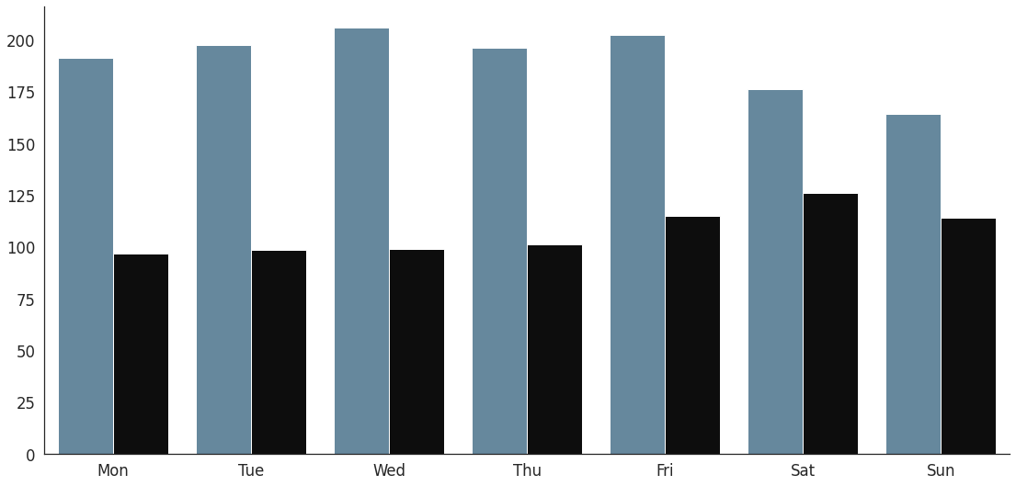
Crime by Time of Day
Herein we define daytime to be between 7:00 am - 7:00 pm
Notice how the percentage differentials for weekend day vs night are more proportional than weekdays. Especially for Saturday and Sunday.
Could be due to more people being out at night on the weekend, than during the weekday.
67.54%
63.72%
66.31%
66.66%
66.99%
58.23%
54.30%
41.77%
36.28%
45.70%
Number of Crimes(In Thousands)
33.34%
32.46%
34.01%
33.69%
Ezana Kemmer

Slide 14
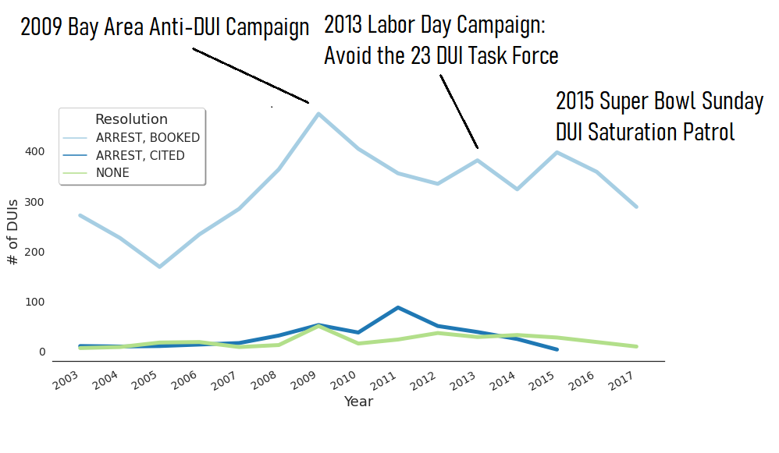
Number of DUI Cases and Resolutions Over Years
Leeza Sergeeva

Slide 15
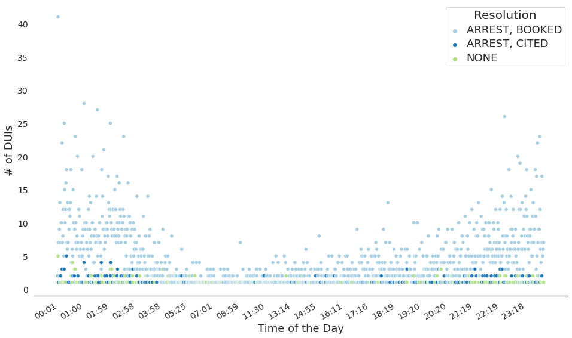
When People Get Arrested for DUI?
Leeza Sergeeva

Slide 16
QUESTIONS?

